Slide 1
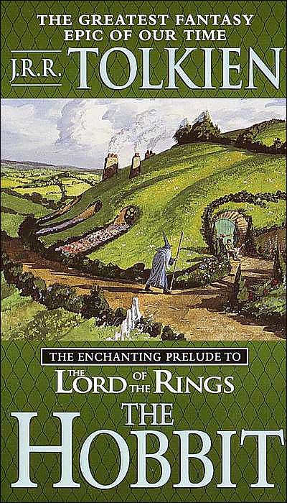
The Hobbit
By : J.R.R Tolkien

Slide 2
J.R.R Tolkien (1892 -1973)

Slide 3
Essential Question
How does background knowledge enhance our reading experience?
Task: Establish test context, Make predictions
Standards Addressed: ELACC7RL1, ELACC7RL2, ELACC7W7, ELACC7W8, ELACC7W9, ELACC7SL1

Slide 4
Background Information on J.R.R Tolkien
John Ronald Reuel Tolkien, as he was christened, was born in Bloemfontein, South Africa in 1892. His years were spent divided between the city and a country farm. His father, an English banker, was making efforts to establish a branch in that country. He left South Africa to return to England with his mother and his brother, Hilary. His father, Arthur, was supposed also to return to England within the next few months. However, Arthur Tolkien died of rheumatic fever while still in South Africa. This left the grieving family in relatively dire straights and on a very limited income.

Slide 5
Background Information on J.R.R Tolkien
An avid reader, Tolkien was influenced by some of the great writers of his day including G.K. Chesterton and H.G. Wells. It was during this period of financial hardship, but intellectual stimulation that Tolkien suffered the loss of his devoted mother. She succumbed to diabetes in 1904 when Tolkien was only 12 years of age.
Throughout his life, Tolkien had cultivated a love of language, especially ancient languages. At Oxford he would major in philology, which is the study of words and language. He would be much influenced by Icelandic, Norse and Gothic mythology. Even some of the characters and place names he would later develop would be drawn from the names from ancient sagas. The forest of Mirkwood, which played a prominent roll in both "The Hobbit" and in "The Lord of the Rings" was borrowed from Icelandic mythology. The names of many of the dwarves in "The Hobbit" were actual place names in the myths.

Slide 6
Background Information on J.R.R Tolkien
In 1925 Tolkien with a colleague published a translation and analysis of "Sir Gawain and the Green Knight." It was a turning point in his career. It brought him notice at Oxford where he was offered the professorship.
"The Hobbit", the work that would make him famous, came out in 1936. He began it one evening while grading exam papers. Seated at his desk, he opened up an exam booklet to find the first page blank. He was surprised and pleased that the student had somehow entirely skipped the page. It seemed an invitation to write, and in that space he began his work on "The Hobbit".

Slide 7
Background Information on J.R.R Tolkien
"The Hobbit" soon became a best seller and made Professor Tolkien famous. He was already well-known as a scholar for his work in Philology, and he was also part of a group of friends who called themselves the Inklings. The center of this group was C.S. Lewis who would long be one of Tolkien's best friends and admirers.
In the late 1930's Tolkien began writing the "Lord of the Rings". Work on the story would go on for ten and a half years.
"The Lord of the Rings" was published in three parts and would become a huge publishing success.

Slide 8
Background Information on J.R.R Tolkien
Fame and fortune were both a blessing and a bane for Tolkien. He enjoyed the popularity of his work. Yet, he was burdened with work responding to his adoring public. After his retirement at Oxford, he and his wife Edith moved to Bournemouth in 1966. Edith died in 1971. The loss of his life's companion did not sit well with Tolkien; yet he struggled on for some two years till his death of Pneumonia on 2 September 1973.

Slide 9
Historical Context of The Lord of the Rings Trilogy
World War I broke out while Tolkien was a student at Oxford University. After finishing his degree, Tolkien joined the Lancashire Fusiliers as a second lieutenant.
In 1916 Tolkien was sent to France, where he and his fellow soldiers faced the terrifying new mechanisms of modern warfare—machine guns, tanks, and poison gas—fighting in some of the bloodiest battles known to human history. Tolkien fought in the Battle of the Somme, a vicious engagement in which over a million people were either killed or wounded.
In the trenches of World War I, Tolkien began recording the horrors of war that would later surface in The Lord of the Rings. Later that year he caught trench fever, an illness carried by lice, and was sent back to England. During his convalescence, he began writing down the stories and mythology of Middle-earth, which would form the basis for The Silmarillion.

Slide 10
The Hobbit : The Prequel
THE HOBBIT Trailer - 2012 Movie - Official [HD]

Slide 11
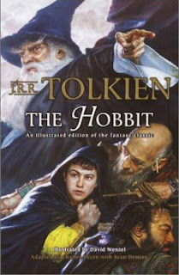
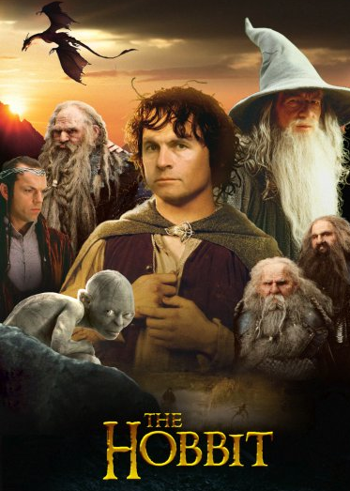
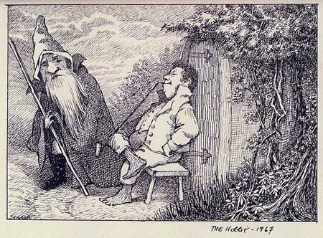
Various Cover Art

Slide 12
Predictions
To predict means to declare or tell in advance; prophesy; foretell. For example: to predict the weather; to predict the fall of a civilization.
Write a well developed paragraph of 5-7 sentences stating your predictions for the prequel, The Hobbit.

Slide 13
Essential Question
What are the elements of effective annotation of a text?
Task: Group and independent reading and note taking
Standards: ELACC7RL1, ELACC7RL3, ELACC7RL6, ELACC7W9, ELACC7SL6, ELACC7L4

Slide 14
Annotation
Definition: An annotation is a brief description or summary of a work such as an article, chapter of a book, book, website, or movie. An annotation attempts to give enough information to make a decision as to whether or not to read the complete work. Annotations may be descriptive or critical.
Close Reading and Annotation: Keeping Middle School Students Focusing on the Text pg (21-24)

Slide 15
S.O.A.P.S.Tone
S: SPEAKER: the voice that tells the story; not the author
O: OCCASION: time and place of the piece; time and place of the piece; context that encouraged the writing to happen; the event that prompted the speaker to speak
A: AUDIENCE: the group of readers to whom this piece is directed
P: PURPOSE: the reason behind the text
S: SUBJECT: general topic, content, and ideas contained in the text in a few words or short phrase
T: TONE: author’s attitude toward the subject; through the author’s choice of words, among other things

Slide 16
Getting Ready to Read
On the next slide we will be reading, The Gettysburg Address, please copy these in your notes to be prepared to read and complete the annotation.
Speaker______________________________
Occasion______________________________
Audience______________________________
Purpose_______________________________
Subject________________________________
Tone__________________________________

Slide 17
Practice Using S.O.A.P.S.Tone
The Gettysburg Address Abraham Lincoln
Four score and seven years ago our fathers brought forth on this continent a new nation, conceived in liberty, and dedicated to the proposition that all men are created equal. Now we are engaged in a great civil war, testing whether that nation, or any nation so conceived and dedicated, can long endure. We are met on a great battlefield of that war. We have come to dedicate a portion of that field as a final resting place for those who here gave their lives that that nation might live. It is altogether fitting and proper that we should do this. But, in a larger sense, we cannot dedicate, we cannot consecrate, we cannot hallow this ground. The brave men, living and dead, who struggled here, have consecrated it far above our poor power to add or detract. The world will little note nor long remember what we say here, but it can never forget what they did here. It is for us, the living, rather, to be dedicated here to the unfinished work which they who fought here have thus far so nobly advanced. It is rather for us to be here dedicated to the great task remaining before us—that from these honored dead we take increased devotion to that cause for which they gave the last full measure of devotion, that we here highly resolve that these dead shall not have died in vain—that this nation, under God, shall have a new birth of freedom— and that government of the people, by the people, for the people, shall not perish from the earth.

Slide 18
Answers for Gettysburg Address Annotation
Speaker: A leader of a nation of people: United States President
Occasion: The Civil War in the United States
Audience: Actual: Union supporters and defenders: Ultimate: Readers of Historical Information
Purpose: To enlist continued support for the war effort and for freedom
Subject: Perseverance of a nation for the cause of freedom
Tone: Passionate regarding unity and freedom

Slide 19
Chapter 1: Group Read Aloud
Practice Annotation with Chapter 1 of The Hobbit
Focus your notes on the elements of plot, character/characterization, literary elements, prose style of the author, and any unknown words (explore these!)
Homework: Read Chapter 2, annotate with attention to Tolkien’s literary strategies using your own background knowledge of diction, syntax, imagery, figurative language, tone, style, etc. These will be discussed in class tomorrow.

Slide 20
Essential Question
What literary concepts should I notice in literary analysis?
Task: Illustrate terms, search text, identify sentence structure, echo write
Standards: ELACC7RL3, ELACC7RL4, ELACC7W9, ELACC7L4, ELACC7L5, ELACC7L1

Slide 21
Homework from Chapter 2
In groups of 3-4, share your S.O.A.P.S.Tone notes from Chapter 2 with your group members.
Each person in the group MUST discuss their ideas for each letter in S.O.A.P.S.Tone.
On a white sheet of paper, write down your best group answers for each letter.
Share your answers with the rest of the class.

Slide 22
Literary Concepts
Connotation- An idea or feeling a word conveys beyond its literal meaning; can be positive or negative (thin vs scrawny)
Diction- A style of speaking or writing with regard to word choices, accent, and enunciation
Syntax- the patterns for the formation of sentences and phrases in a language
Tone- the attitudes of the writer conveyed through his/her writing
Imagery- the use of figurative language to represent objects, actions, or ideas; vivid language appealing to the senses to create images
Symbolism- the practice of representing things by symbols

Slide 23
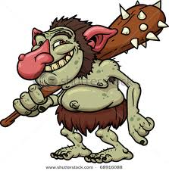
Connotation
“Trolls are slow in the uptake, and mighty suspicious about anything new to them.”
What does “slow in the uptake” suggest?

Slide 24
Diction
William choked. “Shut yer mouth!” he said as soon as he could. “Yer can’t expect folk to stop here for ever just to be et by you and Bert. You’ve et a village and a half between yer, since we come down from the mountains. How much more d’yer want? And time’s been up our way, when yer’d have said ‘thank yer Bill’ for a nice bit o’ fat valley mutton like that is.” (pg 35)
Is this written in an English style of speaking or writing?

Slide 25
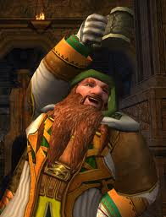
Tone
“Now we are all here!” said Gandalf, looking at the row of thirteen hoods-the best detachable party hoods- and his own hat hanging on the pegs. “Quite a merry gathering! I hope there is something left for the late comers to eat and drink!” What’s that? Tea? No thank you! A little red wine, I think for me.”
What is the tone of this passage? How does
Tolkien use Gandalf to convey this tone?

Slide 26
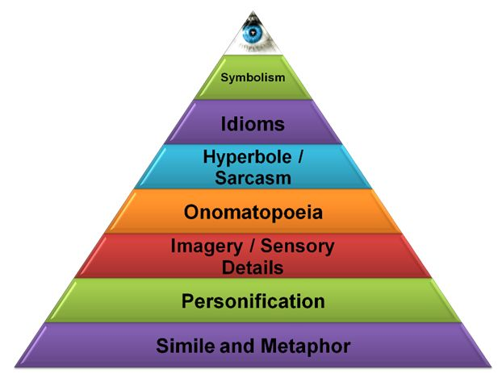
Figurative Language
“The door opened on to a tube shaped hall like a tunnel.”
What type of figurative language is this quotation using?

Slide 27
Symbolism
“The stars were out in a dark sky above the trees. He thought of the jewels of the dwarves shining in the dark caverns.”
What is being suggested through the use of stars and the jewels?

Slide 28
Imagery
“It had a perfectly round door like a porthole, painted green, with a shiny yellow brass knob in the exact middle. The door opened on to a tube-shaped hall like a tunnel: a very comfortable tunnel without smoke, with paneled walls, and floors tiled and carpeted, provided with polished chairs, and lots and lots of pegs for hats and coats- the hobbit was fond of visitors. The tunnel wound on and on, going fairly but not quite straight into the side of the hill- The Hill, as all the people for many miles round called it- and many little round doors opened out of it, first on one side and then on another.”
What image is portrayed in your mind?

Slide 29
Syntax
Bilbo was sadly reflecting that adventures are not all pony-rides in May-sunshine, when Balin, who was always their look-out man, said: “There’s a light over there!” There was a hill some way off with trees they could now see a light shining, a reddish comfortable- looking light, as it might be a fire or torches twinkling. (pg 33)
Are the sentences in this passage
long, short, or choppy ?
Does Tolkien use varied sentence length or
correctly punctuated sentences?

Slide 30
Chapter 3: Group Read Aloud
Practice Literary Concepts with Chapter 3 of The Hobbit
Focus your notes on the elements of connotation, diction, syntax, tone, figurative language, imagery, and symbolism.
Homework: Locate and write down 2 examples of simple, compound, complex, and compound-complex. (Copy a passage from the book and highlight each type a sentence a different color)

Slide 31
Types of Sentences
Simple: A simple sentence is a sentence with one independent clause.
Example: I love simple sentences.
Compound: A compound sentence contains two or more independent clauses.
Example: I love conjunctive adverbs, but my students love pronouns better.
Complex: A complex sentence is a sentence that contains one independent clause and one or more dependent clauses.
Example: Because life is complex, we need complex sentences.
Compound/Complex: A compound-complex sentence contains two or more independent clauses and one or more dependent clauses.
Example: Because I am an English teacher, some people expect me to speak perfectly, and other people expect me to write perfectly.

Slide 32
Essential Question
What can text comparison teach us about authors’ unique styles?
Task: View Clips, Group Discussion of artistic choices, employ literary terms
Standards: ELACC7RL1, ELACC7RL4, ELACC7W9, ELACC7SL1, ELACC7L5

Slide 33
View Chapters 4-9 from the Film Version
The Hobbit - Directed by Jules BASS - Animated Film
Discuss and Complete Venn Diagram on the following:
*Determine in what ways the film depiction was similar/different from what you visualized while you read
*As you skim through your text while you watch the clip, identify dialogue matches or places where the film differs from the written text.
*Determine reasons for the changes that were made to the film version

Slide 34
Venn Diagram of Similarities and Differences
Text Video

Slide 35
Reflection
Having read aloud, read independently, and viewed a film clip, articulate your ideas about word choices Tolkien has made; for example old fashioned, modern, simple or sophisticated, varying by character; and connotations of language.

Slide 36
Essential Question
Why is it important to vary sentence structure in my writing?
Task: Understand the composition and the function of phrases and clauses in sentences.
Standards: ELACC7RL5, ELACC7W9, ELACC7SL1,

Slide 37
Chapter 10: Independent Reading
As we independently read Chapter 10, write down particularly elegant or interesting sentences for later discussion.
You must write down a minimum of 10 sentences while reading.

Slide 38
The PHRASE
A group of two or more grammatically linked words that do not have subject and predicate is a phrase. For example:
The girl is at home, and tomorrow she is going to the amusement park.
You can see that “the amusement park” is a phrase located in the second clause of the complete sentence above.
Phrases act like parts of speech inside clauses. That is, they can act as nouns, adjectives, adverbs and so on.

Slide 39
The CLAUSE
Sentences can be broken down into clauses.
For Example: The boy is going to the school, and he is going to eat there.
This is a complete sentence composed of two clauses. There are mainly two types of clauses: independent clauses and subordinate clauses.
Independent clauses act as complete sentences, while subordinate clauses cannot stand alone and need another clause to complete their meaning. For example:
Independent clause: “The boy went to the school.” Subordinate clause: “After the boy went to the school…”

Slide 40
Mixture of Sentences
What do you think an optimum mixture of these types of sentences would look like?
Would it vary depending on the author or the piece and its tone and purpose?

Slide 41
Annotation of Chapter 11/12 using Cornell Notes
Homework: Read and annotate Chapters 11 paying specific attention to literary elements. (Copy Chapter and Cornell Notes for Students that don’t have books)
Cornell Notes
Students need to add prompts to their blank note sheet to help them focus their notes. In the left hand column, instruct students to identify tone and cite examples. Find examples of figurative language or imagery to set the mood, and identify internal and external conflicts.

Slide 42
Essential Question
What are the elements of an effective argument?
Task: Evaluate Gandalf’s argument to Bilbo from the film version of text
Standards: ELACC7RL4, ELACC7W9, ELACC7SL2, ELACC7SL3

Slide 43
How do we Persuade?
People tend to persuade others by doing things.
These strategies include guilt, repetition, shame, peer pressure, and pride.
View the Film version of Chapter 1 of the Hobbit, where Gandalf and his comrades bring their powers of persuasion to bear a timid hobbit in order to engage him as a burglar in their quest.
The Hobbit - Directed by Jules BASS - Animated Film

Slide 44
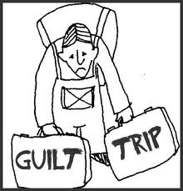
Ticket out the Door
Describe the strategies identified and how well those strategies worked. Guilt, repetition, shame, peer pressure, and pride?

Slide 45
Essential Question
How will I be assessed on this module?
Task: Group peer review chart, rubric review
Standards: ELACC7RL4, ELACC7RI4, ELACC7W2, ELACC7W4, ELACC7SL2, ELACC7L1, ELACC7L5, ELACC7L6

Slide 46
Assessment #1
What will you be asked to do?
Informational/Explanatory Literary Analysis
The Hobbit by J.R.R. Tolkien
Prompt: Why did Tolkien make the choices he did, and how were those choices intended to impact readers?
Identify theme, audience, and purpose.
Identify and analyze literary strategies used to convey theme and purpose including but not limited to plot, setting, characters, characterization, diction, syntax, tone, imagery, figurative language, symbols (motif).
Use primary text only for citations (ideas must be your own).
Uses Shanahan’s graphic organizer to identify theme.
Use précis format to create essay outline.

Slide 47
Planning Guide
Shanahan’s Graphic Organizer
Students identify what a character was like before and after the major crisis of a story, then ponder what it was the author wanted us to learn from this – and what did the character learn.
Crisis
Before
After

Slide 48
Precis Format/Essay Outline
Introduction
Title, author, basic plot summary (1-3 sentences)
Identify character/trait, theme or symbol (thesis)
Identify three examples as evidence (structural)
Body Paragraph 1
Topic sentence
Textual evidence or example (3-4 sentences – text)
How the text proves topic (3-4 sentences – analysis)
Why the topic is important to the novel (3-4 sentences – analysis)
Body Paragraph 2
Topic sentence
Textual evidence or example (3-4 sentences – text)
How the text proves topic (3-4 sentences – analysis)
Why the topic is important to the novel (3-4 sentences – analysis)
Body Paragraph 3
A. Topic sentence
1. Textual evidence or example (3-4 sentences – text)
2. How the text proves topic (3-4 sentences – analysis)
3. Why the topic is important to the novel (3-4 sentences – analysis)
Conclusion Paragraph
Topic sentence related to thesis
Summarize body paragraph 1 (1 summary sentence)
Summarize body paragraph 2 (1 summary sentence)
Summarize body paragraph 3 (1 summary sentence)
Concluding sentence (1 final thought)

Slide 49
Rubric
Category | 4-Exceeds standards | 3 – Meets standards | 2- Approaches Standards | Does not meet | Comments
Focus or Thesis Statement | The thesis statement connects the theme of the story/poem/play to the literary elements to be analyzed. Theme interpretation is beyond the obvious. 25 points | The thesis statement identifies the theme and names the literary elements. 21 points | The thesis statement identifies the theme or names the literary elements but does not do both. 20 points | There is no clearly identifiable thesis statement. 15 points
Sequencing Organization | Analysis of literary elements is logically organized and used to explain the theme of the story/poem/play. 25 points | Analysis of literary elements is logically organized and somewhat used to explain the theme of the story/poem/play. 21 points | Analysis of literary elements is somewhat logically organized but not used to explain the theme of the story/poem/play. 20 points | Analysis of literary elements not present, or off topic. 15 points
Supporting Evidence | Quotes and examples from the text effectively examine the author’s writing style and clearly explain how a literary element develops the theme. 25 points | Quotes and examples from the text examine the author’s writing style and explain how a literary element develops the theme. 21 points | Quotes and examples from the text are used but do not examine the author’s writing style or explain how a literary element develops the theme. 20 points | Quotes and examples from the text are not used 15 points
Sources | The story/poem/play analyzed is cited accurately, both in text and in the works cited page, if applicable. 15 points | The story/poem/play analyzed is mostly cited accurately, both in text and in the works cited page, if applicable. 10 points | The story/poem/play is cited accurately in places in text or works cited page, but not both. 5 points | The story/poem/play analyzed is cited inaccurately or not cited at all. 3 points
Grammar and Mechanics | No errors or very few errors. 10 points | Few errors that do not hinder meaning 7 points | Many errors, but paper is largely readable. 5 points | Many errors interfere with the meaning of the paper. 2 points

Slide 50
Essential Question
What is literary “analysis?”
Task: Model and discuss together the literary elements in Chapter 11-13
Standards: ELACC7RL1, ELACC7RL2, ELACC7RL3, ELACC7W9, ELACC7SL1, ELACC7L4

Slide 51
Chapter 13: Group Read Aloud
Review literary elements: Diction, Tone, Figurative Language, Imagery, Symbolism, and Syntax
Discuss Syntax to Review Phrases, Clauses, and Sentence Structure and Variety
How would students describe Tolkien’s syntactic style? Does he use long or short sentences? How are they composed? What effect does their structure have on the reader?

Slide 52
Essential Question
How is allusion different from reference or allegory?
Task: Discuss the concept of literary allusion; examine allusions in the text
Standards: ELACC7RL4, ELACC7RL6, ELACC7W9, ELACC7SL1, ELACC7L5

Slide 53
Chapter 14: Group Read Aloud
After reading Chapter 14, lead a discussion on literary allusion and how it differs from Reference or Allegory
Allusion- An allusion is a literary device that stimulates ideas, associations, and extra information in the reader's mind with only a word or two. Allusion means 'reference'. It relies on the reader being able to understand the allusion and being familiar with all of the meaning hidden behind the words.
Reference- a mention; allusion
Allegory- reference to a subject that is not explicitly stated.

Slide 54
Examples of Allusion
Allusions in writing help the reader to visualize what's happening by evoking a mental picture. But the reader must be aware of the allusion and must be familiar with what it alludes to. Allusions are commonly made to the Bible, nursery rhymes, myths, famous fictional or historical characters or events, and Shakespeare.
"As the cave's roof collapsed, he was swallowed up in the dust like Jonah, and only his frantic scrabbling behind a wall of rock indicated that there was anyone still alive". The allusion in the sentence above is to Jonah. The reader is expected to recognize the reference to Jonah and the whale, which should evoke an image of being 'swallowed alive' ... in this case, behind a wall of dust and rock.

Slide 55
Examples of Allusion
"Christy didn't like to spend money. She was no Scrooge, but she seldom purchased anything except the bare necessities". Did you spot the allusion to Scrooge? That name should bring to mind an image of someone who 'pinches pennies' and hoards money with a passion. But the allusion only works if the reader is familiar with Charles Dickens' story 'A Christmas Carol'.
In general, the use of allusions by an author shows an expectation that the reader is familiar with the references made, otherwise the effect is lost. A piece of writing with many allusions (some of which may be very obscure) will be very rich with evoked images, but will do nothing for a reader who is not well-read.

Slide 56
Examples of Allusion
See if you can spot the allusions in this paragraph:
"Marty's presence at the dance was definitely a 'Catch 22' situation; if he talked to Cindy she'd be mad at him, but if he ignored her there'd be hell to pay. His anger bubbled to the surface. He realized that by coming to the dance he had brought his problems with him like a Trojan Horse, and he could only hope he would be able to keep them bottled up".

Slide 57
Answer
The first allusion is to the novel 'Catch 22' by Joseph Heller; this should suggest a situation where there is a problem with no right answer ... whatever you do will be wrong. If you have read Heller's novel, you know exactly how Marty is feeling! The second reference is to the Trojan Horse from Virgil's Aeneid, which chronicles the Greeks conquering Troy by giving a gift of a horse to their enemies and filling the belly of the horse with warriors. A vivid image ... if you recognize it. There is also a reference to 'hell', which evokes images from the Bible of something definitely unpleasant. Finally, there is a very subtle reference to 'bottling up' problems, which might suggest an image of tightly containing something, although there is no direct connection to anything. Allusion in the Hobbit contain references to King Lear in Shakespeare and Greek Mythology

Slide 58
Essential Question
How is active listening to an oral/audio text different from reading or viewing?
Task: Audio presentation of 2 Chapters with Vocabulary and Prose Study
Standards: ELACC7RL1, ELACC7RL4, ELACC7RL6, ELACC7RL7, ELACC7SL2

Slide 59
Chapters 15-16 Audio Listening
After listening, analyze the professional reader’s delivery of the text.
Does the delivery sound flowing, musical, staccato, or clipped?
In pairs, examine both chapters and perform a brief analysis noting interesting word choices, the number of sentences in a paragraph, the number of words in a sentence, and the distribution of simple, compound, complex, and compound complex.

Slide 60
Think-Pair-Share Reflection
1. Are there any interesting word choices?
2. Choose 5 paragraphs throughout the 2 Chapters and count the number of sentences.
3. Choose 10 sentences throughout the 2 Chapters and count the number of words in a sentence.
4. In the 10 sentences, how many are simple/compound/complex/compound complex?
5. Compose an annotation of the two chapters using the information you gathered, plus discuss Tolkien’s diction and syntax. Focus on why these choices were made and how they were meant to impact the reader.

Slide 61
Homework
Read and annotate Chapters 17 and 18

Slide 62
Essential Question
How does an author’s unique use of literary elements combine to create his or her voice and style?
Task: In class dramatic reading of novel’s conclusion
Standards: ELACC7RL3, ELACC7RL5, ELACC7RL10, ELACC7W1, ELACC7W1, ELACC7W9, ELACC7SL1, ELACC7SL2

Slide 63
Chapter 19; Group Read Aloud
Construct an arc plot and discuss the overall structure of the chapters
Reflect on the characters and the ways in which the author uses characterization
Review expectations for the writing assessment
Students read and annotate, “Windows on the life and work of J.R.R. Tolkien.” This is used to show what the analysis of literary elements and devices should look and sound like.
Windows on the life and work of JRR Tolkien

Slide 64
Conduct Assessment 1
Informational/Explanatory Literary Analysis
The Hobbit by J.R.R. Tolkien
Prompt: Why did Tolkien make the choices he did, and how were those choices intended to impact readers?
Identify theme, audience, and purpose.
Identify and analyze literary strategies used to convey theme and purpose including but not limited to plot, setting, characters, characterization, diction, syntax, tone, imagery, figurative language, symbols (motif).
Use primary text only for citations (ideas must be your own).
Uses Shanahan’s graphic organizer to identify theme.
Use précis format to create essay outline.

Slide 65
Essential Question
What reading strategies constitute “close” reading?
Task: Read a short story, annotate, use graphic organizer to understand theme
Standards: ELACC7RL9, ELACC7RL6, ELACC7RL3, ELACC7W9, ELACC7SL1, ELACC7L5

Slide 66
“-And the Moon Still Be as Bright” from the Martian Chronicles
Teacher Read “- And the Moon Still Be as Bright”
Theme- a unifying or dominant idea in a piece of writing
Model of the Shanahan Graphic Organizer
Before
After
Crisis

Slide 67
“Naming of Names” By Ray Bradbury
Student’s will independently read “The Naming of Names,” from the 7th grade Literature Book.
Complete Their Own Shanahan Graphic Organizer
Homework: Tomorrow students will discuss the allegory and treatment of Native Americans in the Western expansion of the United States. Read Trail of Tears: The Native American Problem in the New World Trail of Tears: The Native American "Problem" in the New World. Annotate the article and complete the 4 square perspective.

Slide 68
Create a “Four-Square Perspective” to explain and analyze the Native Americans
Culture | Homeland
Treatment | Other

Slide 69
Essential Question
What are the elements of prose style of writing?
Task: Review literary terms, phrases, clauses, and sentence fluency
Standards: ELACC7RL1, ELACC7RL4, ELACC7W2, ELACC7L5

Slide 70
Evaluate “Naming of Names”
Assign ½ page of the “Naming of Names” to evaluate diction, syntax, tone, figurative language, and imagery.
Diction- A style of speaking or writing with regard to word choices, accent, and enunciation
Syntax- the patterns for the formation of sentences and phrases in a language
Tone- the attitudes of the writer conveyed through his/her writing
Figurative Language- any expressive use of language, as a metaphor, simile, personification, in which words are used in other than their literal sense
Imagery- the use of figurative language to represent objects, actions, or ideas; vivid language appealing to the senses to create images

Slide 71
Analysis of “Naming of Names”
After evaluating the ½ page of text, construct an analysis of 5 to 7 well constructed sentences with the information gathered.
Homework Read and Annotate “Why Do We Read Science Fiction?,” by Carol Pinchefsky. Complete a summary of the information to share in class tomorrow.

Slide 72
Essential Question
What constitutes “bias” in a summary?
Task: Share homework summaries, Begin reading “The Shoddy Lands” with Annotation
Standards: ELACC7RI2, ELACC7W1, ELACC7SL4, ELACC7SL6

Slide 73
Summary without Bias
Discuss the concept of a summary without bias
Bias within the summary- involves keeping overly declarative statements out of the summary. Phrases like “The author never” or “the author always says” will lead the reader to believe you are for one side or another and are not presenting the information fairly.

Slide 74
Biased or Unbiased?
C. S. Lewis: The Creator of Narnia
C. S. Lewis, or Jack Lewis, as he preferred to be called, was born in Belfast, Ireland (now Northern Ireland) on November 29, 1898. He was the second son of Albert Lewis, a lawyer, and Flora Hamilton Lewis. His older brother, Warren Hamilton Lewis, who was known as Warnie, had been born three years earlier in 1895. This somewhat idyllic boyhood came to an end for Lewis when his mother became ill and died of cancer in 1908. Barely a month after her death the two boys were sent away from home to go to boarding school in England.
Lewis hated the school, with its strict rules and hard, unsympathetic headmaster, and he missed Belfast terribly. Fortunately for him, the school closed in 1910, and he was able to return to Ireland. After a year, however, he was sent back to England to study. This time, the experience proved to be mostly positive. As a teenager, Lewis learned to love poetry, especially the works of Virgil and Homer. He also developed an interest in modern languages, mastering French, German, and Italian.
In 1916 Lewis was accepted at University College, the oldest college (founded 1249) at Oxford University. Oxford, along with Cambridge University, had been a leading center of learning since the Middle Ages. Soon after he entered the University, however, Lewis chose to volunteer for active duty in World War I, to serve in the British Army then fighting in the muddy trenches of northern France.
Following the end of the war in 1918, Lewis returned to Oxford, where he took up his studies again with great enthusiasm. In 1925, after graduating with first-class honors in Greek and Latin Literature, Philosophy and Ancient History, and English Literature, Lewis was elected to an important teaching post in English at Magdalen College, Oxford. He remained at Oxford for 29 years before becoming a professor of medieval and renaissance literature at Magdalene College, Cambridge, in 1955.
Who does this remind you of?

Slide 75
Biased or Unbiased
Lewis was already an experienced and prolific writer who had published numerous books, including a science fiction trilogy, a scholarly book about medieval allegory, a book of poetry, and some works on religion and faith. He decided to try writing a book for children, using his meeting with the evacuees and the picture of the Faun. The writing was difficult at first, but eventually he started to see some other pictures that came into the story. Lewis said the Christ-like lion, Aslan, "came bounding in" and the pages started to fly by. And The Lion, the Witch, and the Wardrobe was born!
After he finished writing, Lewis excitedly read his new book aloud to his friend and fellow author J.R.R. Tolkien. Lewis and Tolkien were members of a small, informal literary club at Oxford called The Inklings, which met to discuss members' work-in-progress and other literature-related topics. In the past, Tolkien had read his works, including parts of The Hobbit and The Lord of the Rings, to Lewis and the other Inklings, who gave him useful feedback and support. Lewis expected Tolkien to provide the same kind of encouragement and constructive criticism. But, as Lewis's biographer George Sayer records, Tolkien thought The Lion, the Witch, and the Wardrobe was terrible. Tolkien argued that witches and Santa Claus and talking animals and figures from Greek mythology didn't belong in the same story – that no book should have so many different types of characters jumbled together. Luckily for us, some of Lewis's other friends loved the book, and so he published it in 1950, two years after writing it.

Slide 76
Biased/Unbiased
Answers: 1st one was Unbiased, 2nd one was Biased
Unbiased writing is comparable to informational writing
Biased writing is comparable to argumentative writing

Slide 77
Think, Pair, Share
On a line sheet of paper, complete the following tasks from “Why Do We Read Science Fiction,” with your partner.
What was the author’s audience for this writing?
What was the author’s purpose for this writing?
Read your summaries written for homework last night and listen for bias in your partner’s writing. Write down any sentences in each other’s summary that was biased, or your opinion.
Help to fix each other’s summaries so they are unbiased

Slide 78
“The Shoddy Lands”
Read using the S.O.A.P.S.Tone strategy to annotate “The Shoddy Lands”
S: SPEAKER: the voice that tells the story; not the author
O: OCCASION: time and place of the piece; time and place of the piece; context that encouraged the writing to happen; the event that prompted the speaker to speak
A: AUDIENCE: the group of readers to whom this piece is directed
P: PURPOSE: the reason behind the text
S: SUBJECT: general topic, content, and ideas contained in the text in a few words or short phrase
T: TONE: author’s attitude toward the subject; through the author’s choice of words, among other things

Slide 79
“The Shoddy Lands”
Speaker______________________________
Occasion______________________________
Audience______________________________
Purpose_______________________________
Subject________________________________
Tone__________________________________
Also make any additional line for Diction and find words that are specifically beautiful or concise or words that are un known

Slide 80
Essential Question
How do themes tend to compare or recur within a genre?
Task: Discuss reflections from “The Shoddy Lands,” evaluate texts in light of informational articles on genre
Standards: ELACC7RI1, ELACC7RI2, ELACC7RI6, ELACCRL1, ELACC7RL2, ELACC7RL6, ELACC7W2, ELACC7L1, ELACC7L2, ELACC7L3

Slide 81
Qualities of Science Fiction Genre
Copy this chart into your notes to complete this task.
Review “Why Do We Read Science Fiction” and pick out unique and attractive qualities of the Science Fiction Genre and place in pink boxes.
“And the Moon still be as Bright”
“The Shoddy Lands”

Slide 82
Qualities of Science Fiction Genre
Here are some examples of qualities of science fiction genre
Review the texts, “-And the Moon still be as Bright” and “The Shoddy Lands” and identify ways in which these 2 stories illustrate these qualities.
 | Unusual | Inspirational | Figurative Language | Optimism | Lonely Suggested Comforting Words
“And the Moon still be as Bright”
“The Shoddy Lands”

Slide 83
Similarities and Differences between Bradbury and Lewis: Paying attention to diction, syntax, tone, imagery, and figurative language
Bradbury Lewis

Slide 84
Essential Question
What are the best strategies for incorporating vocabulary I pick up from texts I read?
Tasks: Read “The Martian” from the Martian Chronicles, identify new vocabulary, complete Frayer Models
Standards: ELACC7RL4, ELACC7SL6,

Slide 85
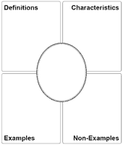
“The Martian”- Group Read Aloud
Annotation to focus on DICTION and specifically words that the students find particularly beautiful or concise or words that are unknown.
Use Frayer Model to explore
10 words in which you are
unfamiliar (Use dictionaries,
thesauruses, and the
internet)

Slide 86
Essential Question
Why is it important to adapt my speech to specific purposes?
Task: Examine vocabulary pulled from Tasks 2-6
Standards: ELACC7RL1, ELACC7RI1, ELACC7W2, ELACC7W9, ELACC7L6, ELACC7L1

